Slide 1
Introduction
CHRIST
Deemed to be University
Crude oil, being a globally traded commodity, is sensitive to changes in the U.S. dollar index,
which reflects the dollar’s relative value to major world currencies. Inflation and CPI are
additional indicators that help gauge economic stability and purchasing power. These factors serve as key indicators in understanding how oil prices move relative to broader economic conditions.
Problem Statement
Crude oil prices are highly volatile and influenced by macroeconomic factors like the U.S.
dollar strength, inflation rates, and the Consumer Price Index (CPI), making accurate
forecasting is challenging for businesses and policymakers. A predictive model that effectively integrates these indicators is needed to improve forecasting accuracy, mitigate financial risks, and enhance strategic decision-making in industries reliant on oil.

Slide 2
Data Dictionary
Variables | Data Type | Description
Date | Date/Time | The date of the observation in MM/DD/YY format.
Crude_Price | Float | The price of crude oil (USD per barrel) at the given date.
USD_Currency_Index | Float | A measure of the value of the U.S. dollar relative to a basket of foreign currencies.
US_Inflation_Rate | String | The inflation rate in the U.S. as a percentage (e.g., "2.1%").
US_Inflation | Float | The inflation factor, a decimal representation of the inflation rate (e.g., 0.021 for 2.1%).
US_CPI | Float | The U.S. Consumer Price Index, which measures changes in the price level of consumer goods.

Slide 3
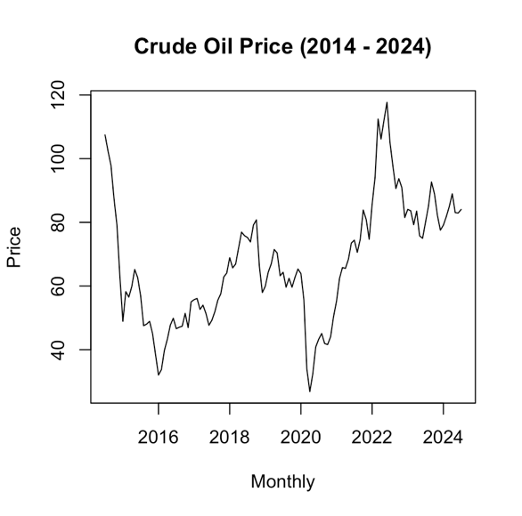
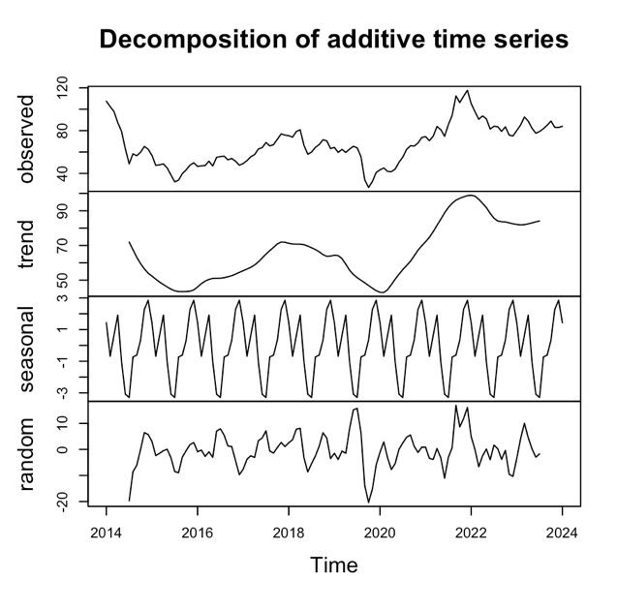
Proposed Solution
The graph shows that crude price has both trend and seasonality

Slide 4
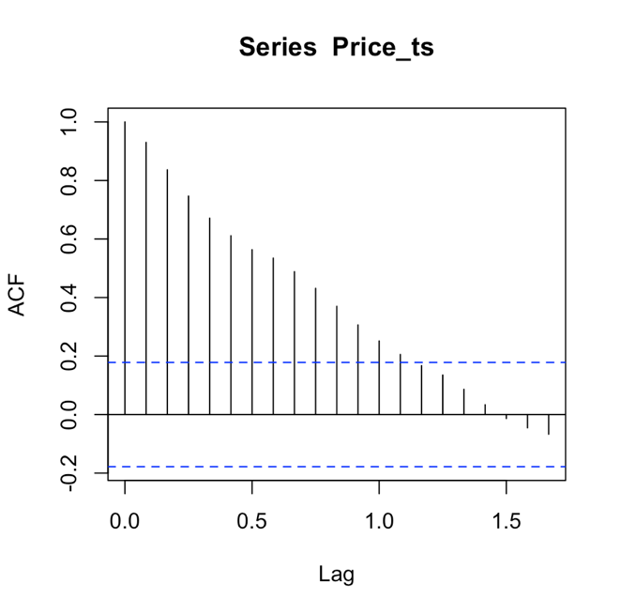
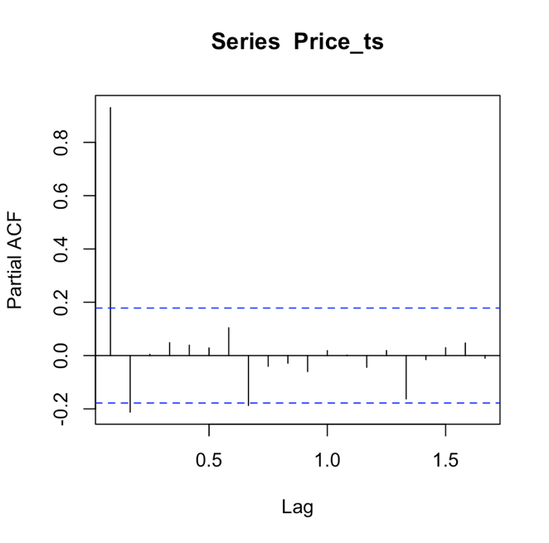
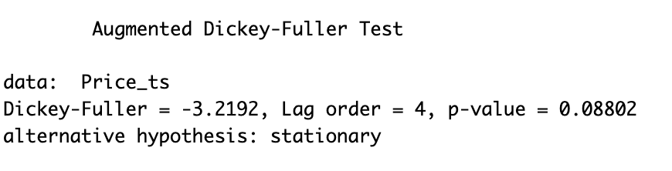
1.ARIMA
ACF Test PACF Test ADF Test
Graph is dying down. so p value in p,d,q in 0.
One spike is above blue line, so q is 1
p value is 0.088 >0.05 so it is not stationary, so make it stationary. no. of differentiation is 1 ie, d=1 is needed to make the series stationary

Slide 5
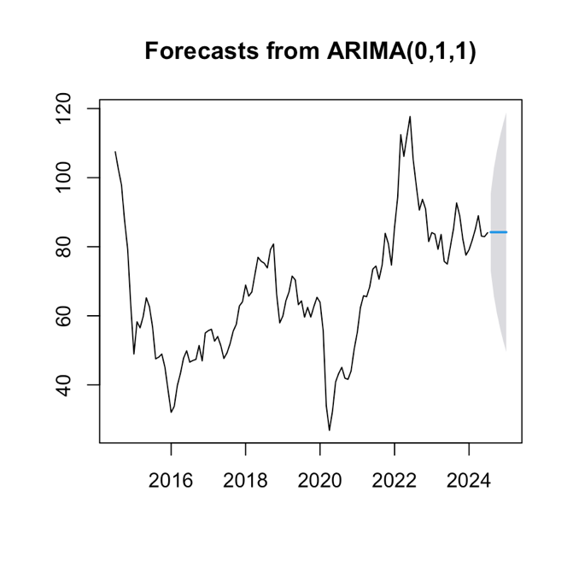
1.ARIMA
Leader Board
Model | RMSE | AIC | BIC
ARIMA | 5.669 | 762.065 | 767.640

Slide 6
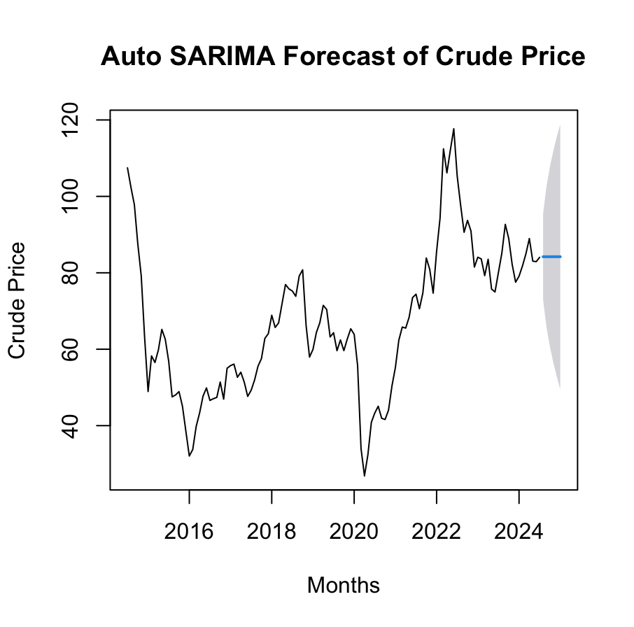
2. SARIMA
Leader Board
Model | RMSE | AIC | BIC
ARIMA | 5.669 | 762.065 | 767.640
SARIMA | 5.441 | 721.997 | 735.408

Slide 7

3. SARIMAX
Leader Board
Model | RMSE | AIC | BIC
ARIMA | 5.669 | 762.065 | 767.640
SARIMA | 5.441 | 721.997 | 735.408
SARIMAX | 5.189 | 761.798 | 784.164

Slide 8
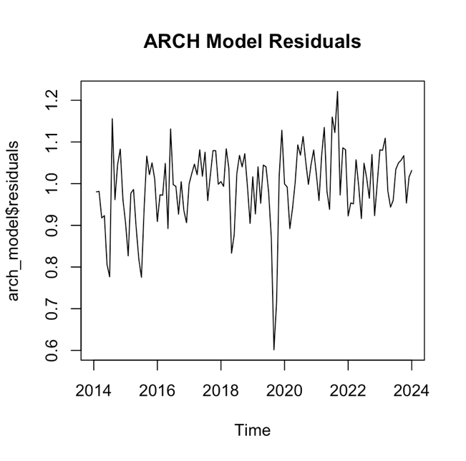
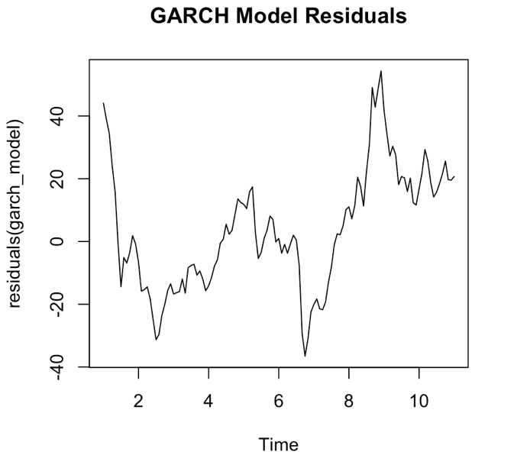
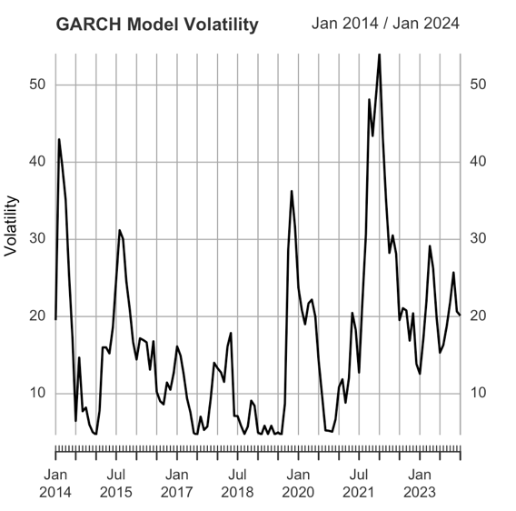
4. ARCH and GARCH
Leader Board
Model | RMSE | AIC | BIC
ARIMA | 5.669 | 762.065 | 767.640
SARIMA | 5.441 | 721.997 | 735.408
SARIMAX | 5.189 | 761.798 | 784.164
ARCH | 53.067 | 994.080 | 1002.47
GARCH | 53.299 | 994.795 | 1005.98

Slide 9
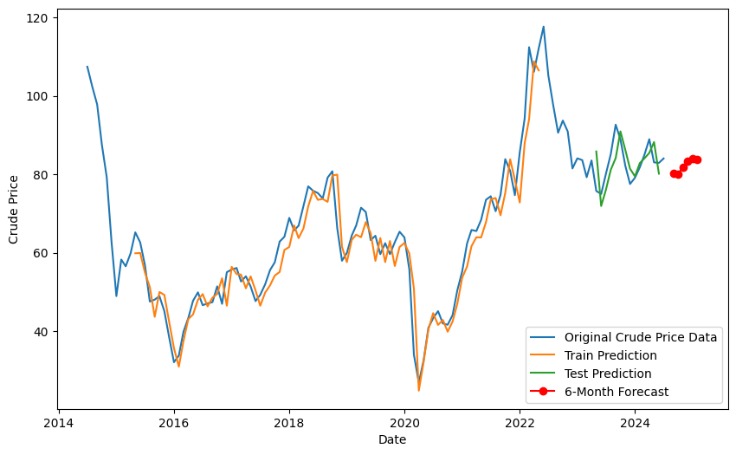
5. LSTM
Forecasted Value Plot
Leader Board
Model | RMSE | AIC | BIC
ARIMA | 5.669 | 762.065 | 767.640
SARIMA | 5.441 | 721.997 | 735.408
SARIMAX | 5.189 | 761.798 | 784.164
ARCH | 53.067 | 994.080 | 1002.47
GARCH | 53.299 | 994.795 | 1005.98
LSTM | 5.360 | 63849.013 | 84235.581

Slide 10
Model Comparison
Final Leader Board
Model | RMSE | AIC | BIC
ARIMA | 5.669 | 762.065 | 767.640
SARIMA | 5.441 | 721.997 | 735.408
SARIMAX | 5.189 | 761.798 | 784.164
ARCH | 53.067 | 994.080 | 1002.47
GARCH | 53.299 | 994.795 | 1005.98
LSTM | 5.360 | 63849.013 | 84235.581
Choosing the Best Model
Best Model: SARIMAX has the lowest RMSE (most accurate predictions), but SARIMA has the best balance between fit and complexity with the lowest AIC and BIC.
Worst Models: ARCH and GARCH models have high RMSE, AIC, and BIC, indicating poor performance.
LSTM performs well in terms of RMSE but has much higher AIC and BIC, suggesting overfitting or excessive complexity for this dataset.

Slide 11

Analysis of the Solution
Month | Crude Price
Aug 2024 | 85.59 USD
Sep 2024 | 87.07 USD
Oct 2024 | 85.14 USD
Nov 2024 | 84.68 USD
Dec 2024 | 89.01 USD
Jan 2025 | 89.38 USD
The solid black line represents historical crude oil prices from 2014 to 2024. The prices exhibit significant volatility, with notable peaks around 2018 and 2022, reaching as high as approximately 120 USD per barrel. Periods of decline are also visible, with lows around 40 USD per barrel.
The forecast suggests that crude oil prices will hover around 85–89 USD per barrel through late 2024 into early 2025. This indicates a relatively stable period after the volatility seen in previous years.

Slide 12
Recommendations
Hedge Against Price Fluctuations: Lock in crude oil prices (84–89 USD) to stabilize costs and minimize risks from minor fluctuations.
Monitor Economic Indicators: Track the USD, inflation, and CPI regularly to adjust strategies based on external economic changes.
Scenario Planning: Prepare for uncertainties by simulating different oil price scenarios to guide decision-making.
Diversify Energy Sources: Invest in renewable energy to reduce dependence on oil and mitigate long-term risks.
Leverage Short-Term Stability: Take advantage of stable crude oil prices for investments like oil futures for consistent short-term returns.
Evaluate and Adjust Pricing Strategies: For businesses directly affected by oil prices, such as transportation or manufacturing, consider adjusting pricing strategies for products and services to reflect anticipated price stability or fluctuations.
Review and Adjust Capital Expenditure Plans: Given the projected stability in crude oil prices, consider accelerating or delaying capital expenditures related to oil-dependent operations. Use the period of relative stability to reassess long-term investment plans and align them with future market expectations.

Slide 13
Conclusion
The forecasted stability of crude oil prices between 84 and 89 USD per barrel from late 2024 to early 2025 provides a window of opportunity for businesses, investors, and policymakers to make informed decisions. Despite this period of projected steadiness, the inherent uncertainty in commodity markets requires continuous monitoring of key economic indicators such as the USD index, inflation rates, and the Consumer Price Index (CPI).Implementing strategies such as hedging, optimizing supply chain management, diversifying energy sources, and leveraging advanced analytics can help mitigate risks and capitalize on the current stability in oil prices.

